Slide 1
MICROSOFT WORD
Prepared By
Sushil Varma

Slide 2
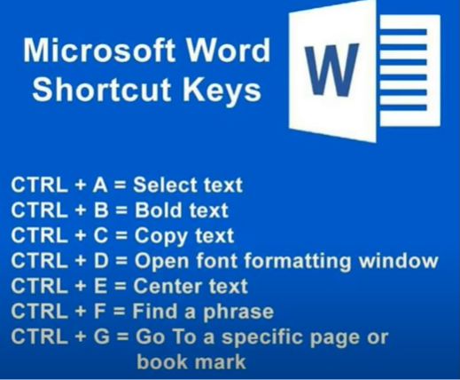
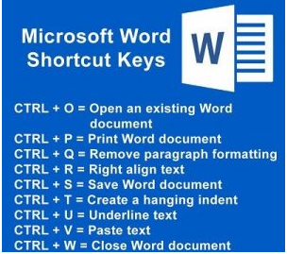

Slide 3
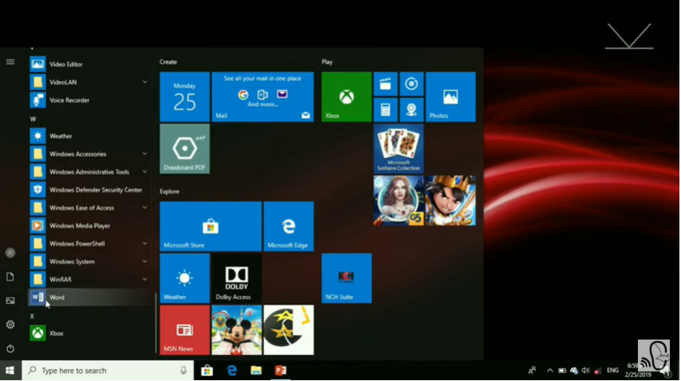

Slide 4
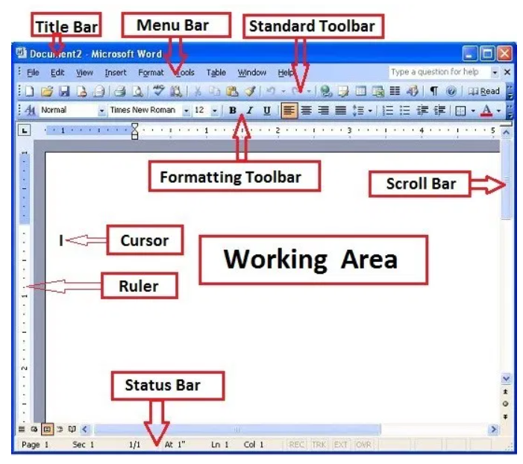

Slide 5
THANK YOU

